Slide 1

English IV
3rd Quarter
Week 2
SIGNAL WORDS
march 29, 2023

Slide 2
Fill in the missing letters. (Blackboard Activity)

Slide 3
Walk
Talk
Speak
Work

Slide 4
Walk
Talk
Speak
Work
carefully

Slide 5
Walk
Talk
Speak
Work
carefully
softly

Slide 6
Walk
Talk
Speak
Work
carefully
softly
politely

Slide 7
Walk
Talk
Speak
Work
carefully
softly
politely
quietly

Slide 8
DO THIS DURING GROUP
ACTIVITY
Walk
Talk
Speak
Work
carefully
softly
politely
quietly

Slide 9

Look at the picture

Slide 10

Look at the picture

Slide 11
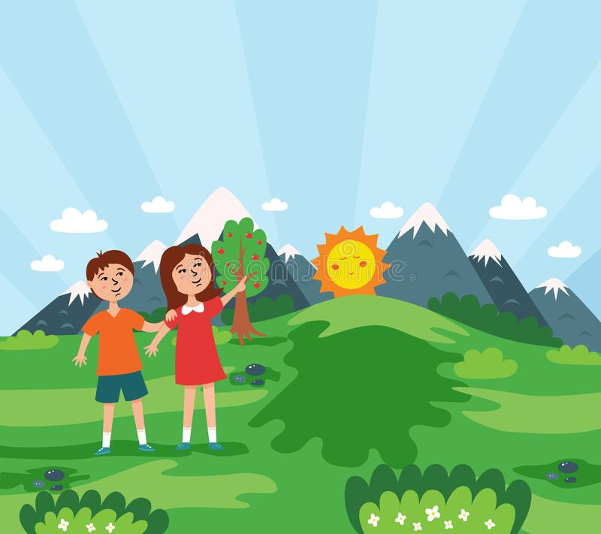

Slide 12
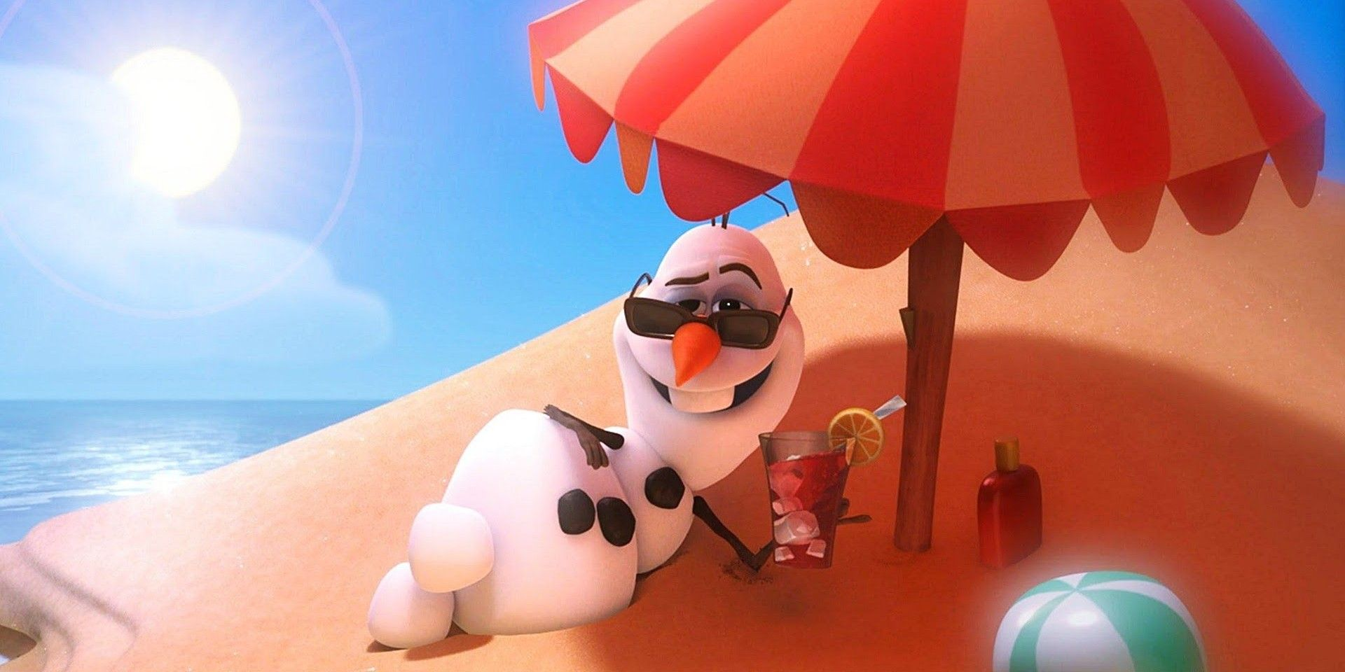

Slide 13
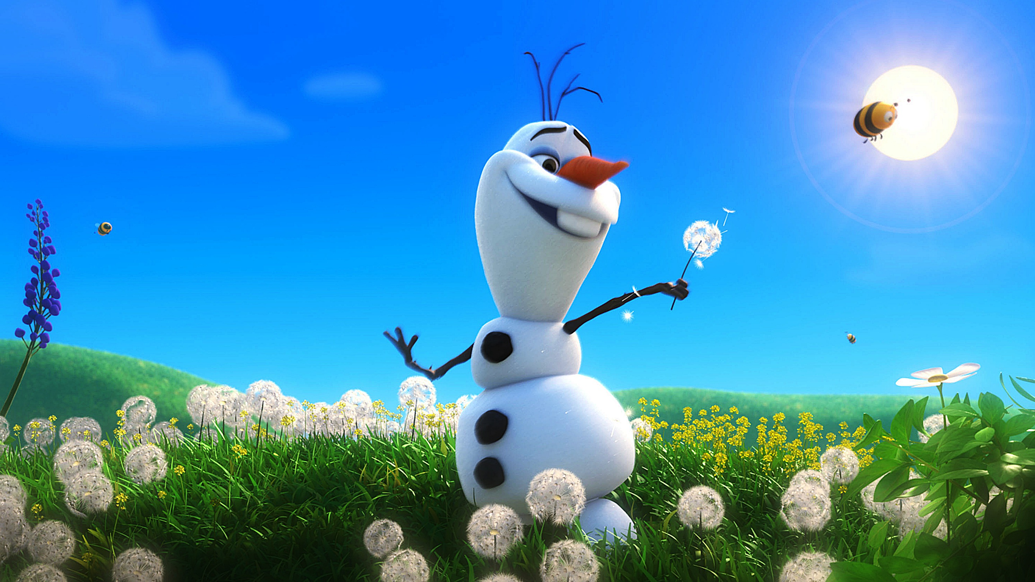

Slide 14
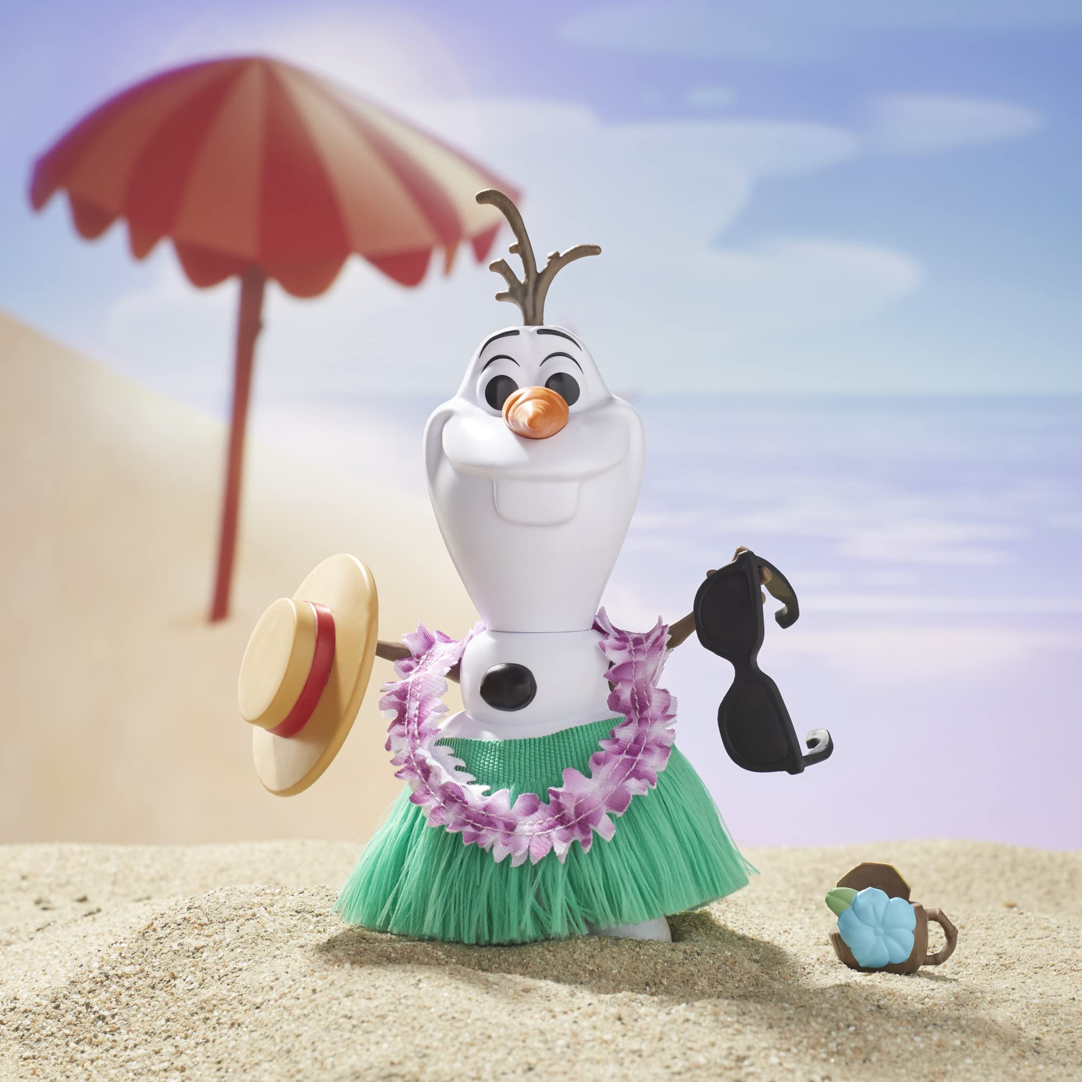

Slide 15


Slide 16
Let’s read a poem

Slide 17
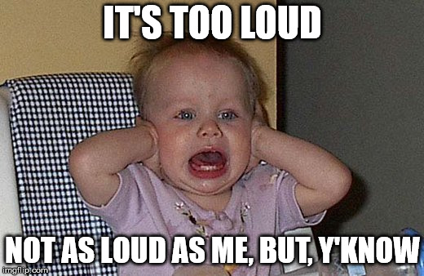
Read loudly…but not too loud

Slide 18
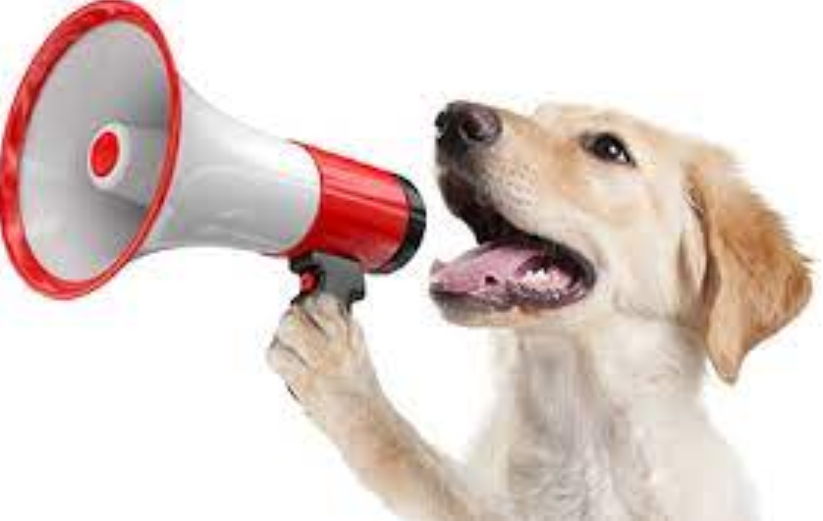
Pronounce the word…clearly

Slide 19

How do we sit?
-Properly
-Sit erect

Slide 20
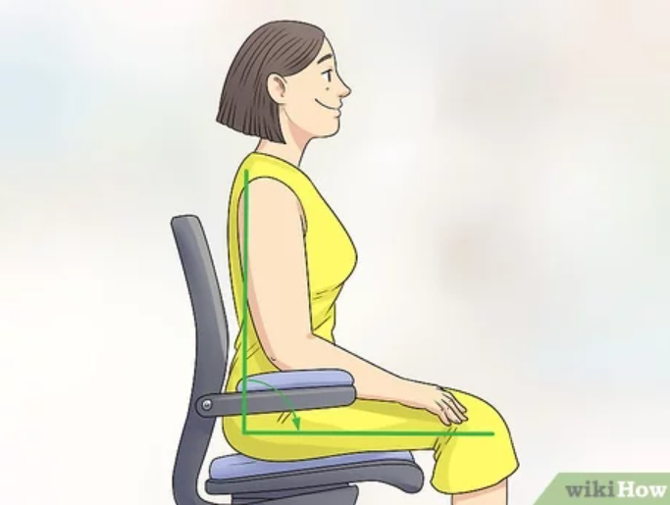

Slide 21
Standard for oral reading
Read loudly…but not too loud
Pronounce the word…clearly
How do we sit? Properly / sit erect

Slide 22

Guess what’s the word based
on the picture.

Slide 23


_ _ _ _ _ C H

Slide 24
S_ _ _ _ C H

Slide 25
STRETCH

Slide 26
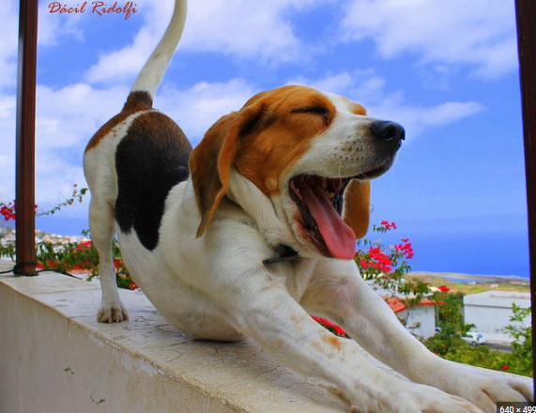
Stretch – To extend one's limbs or body to their full length

Slide 27

_ _ _ N

Slide 28
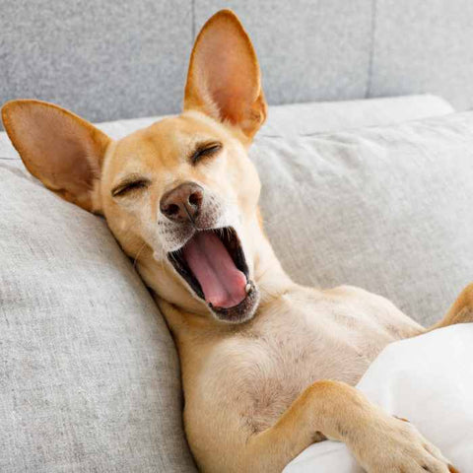
Yawn – To open one's mouth wide and inhale deeply

Slide 29

D_ SK

Slide 30
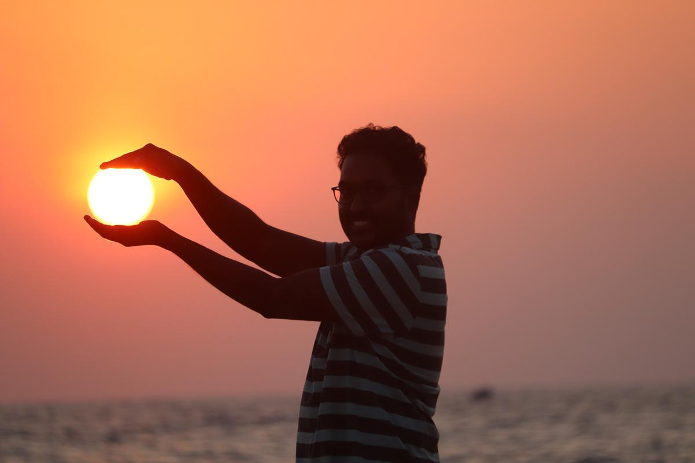
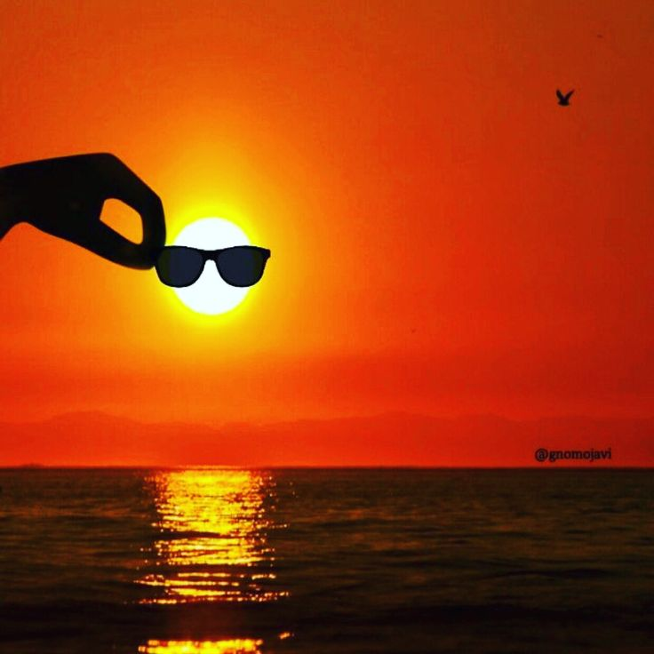
Dusk – light becoming dark.

Slide 31
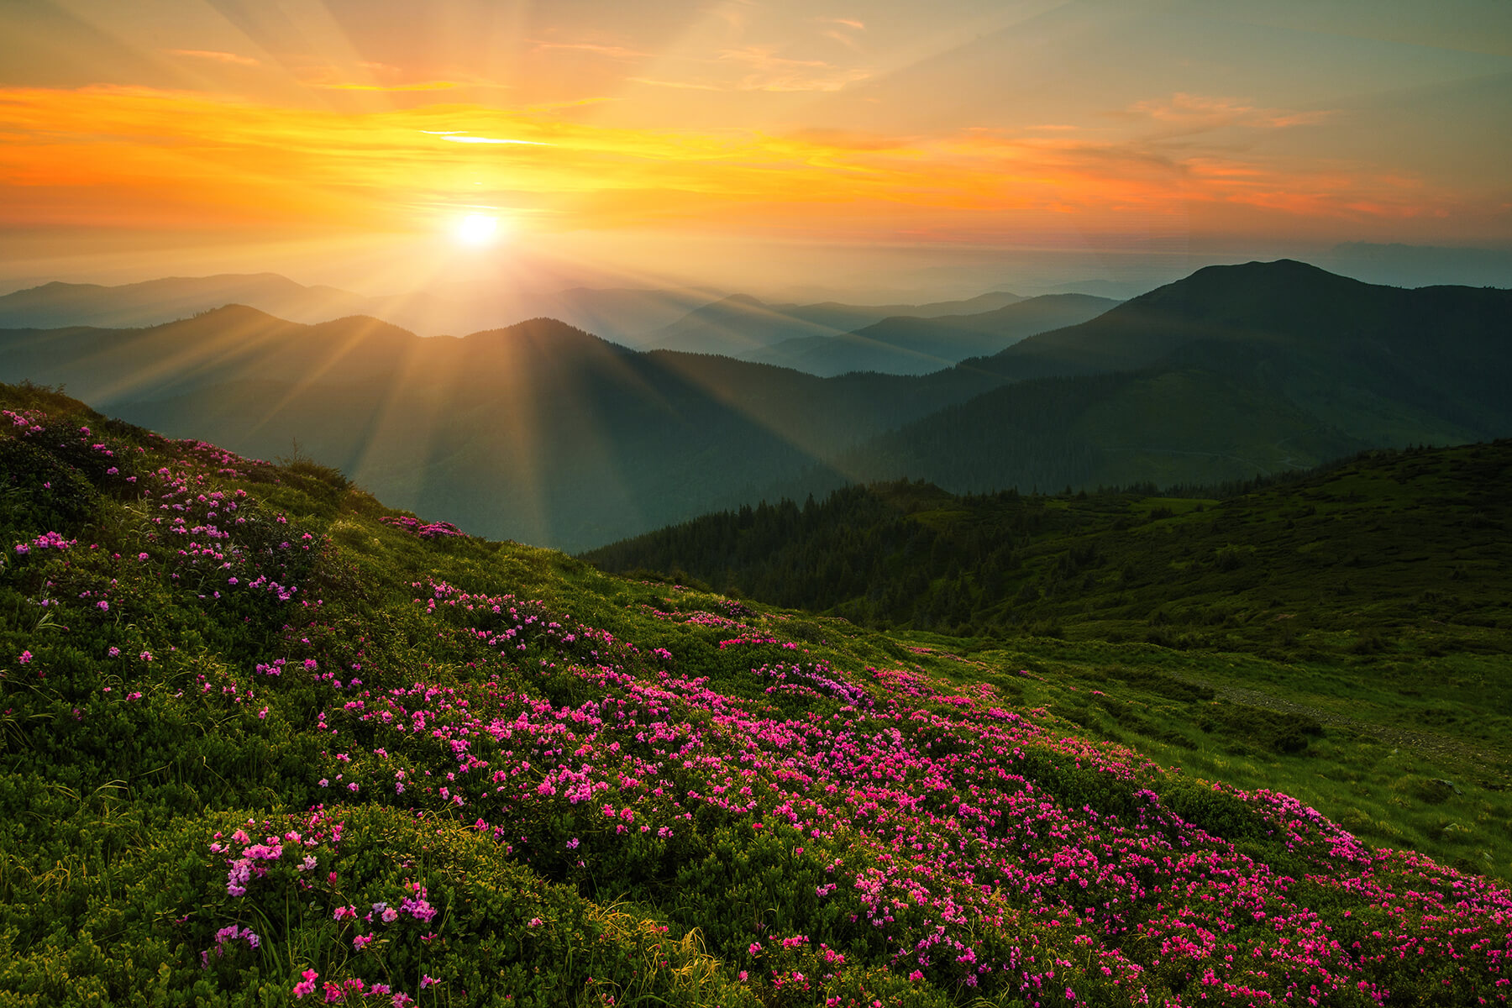
D_ W _

Slide 32
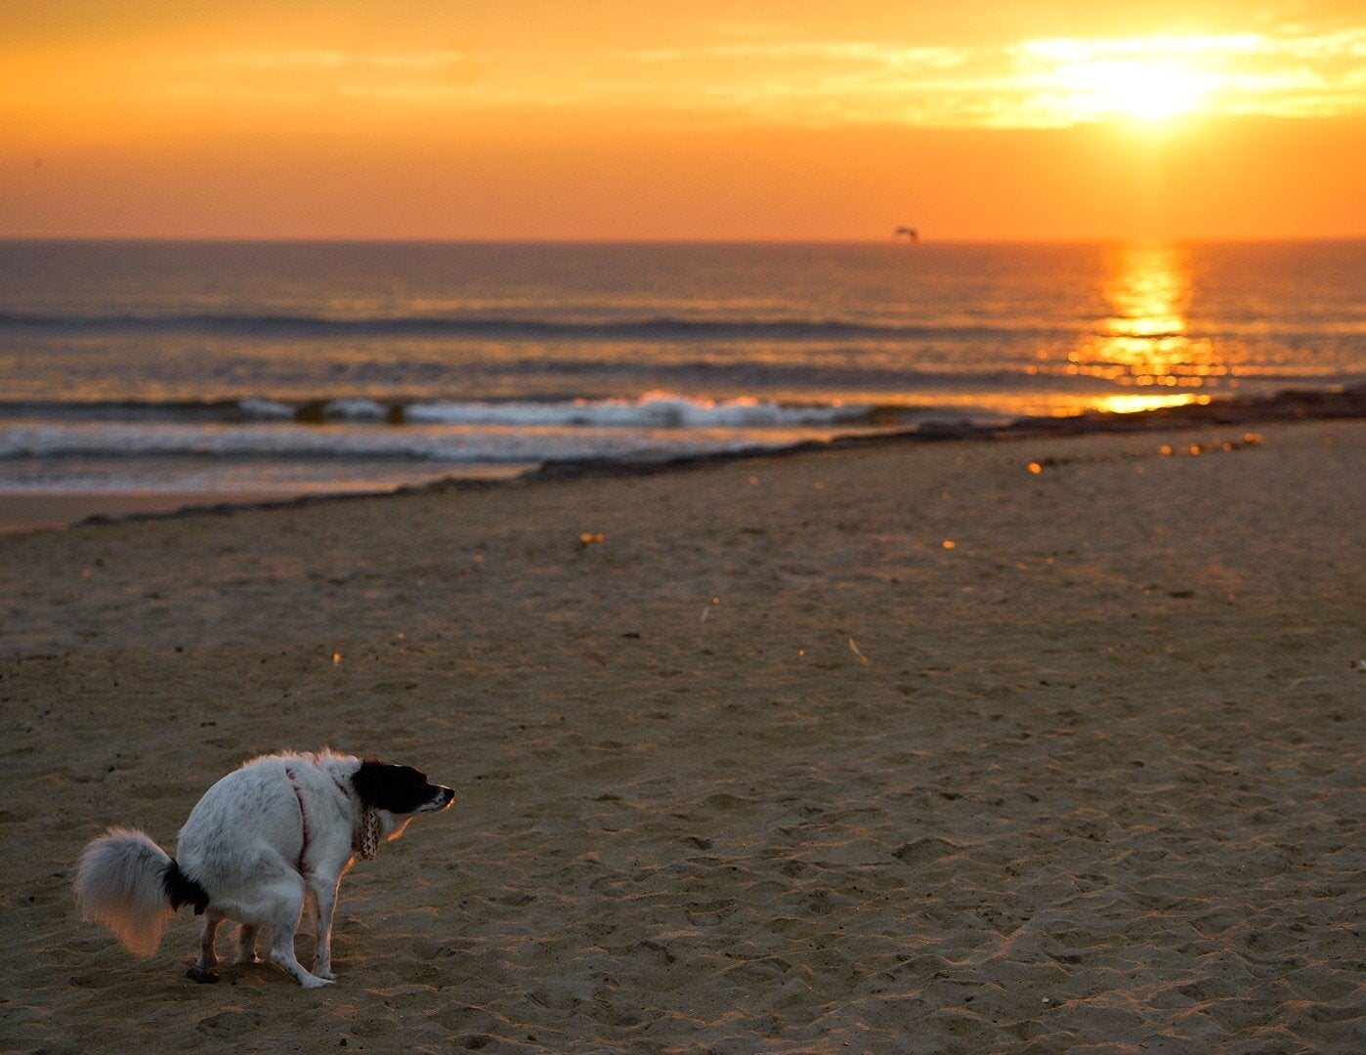
Dawn – beginning to lighten or shine.

Slide 33
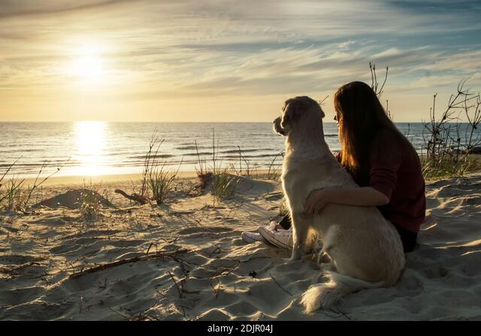
Dawn – beginning to lighten or shine.

Slide 34
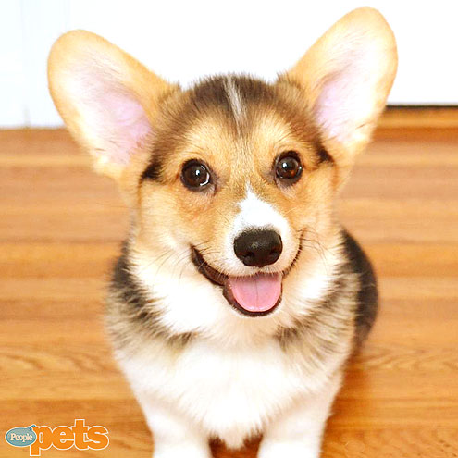
G_ _ _ _ _ _ _

Slide 35

G R _ _ _ _ _ _

Slide 36
G R _ _ _ _ _ L

Slide 37
G R _ _ _ _ U L

Slide 38
G R _ _ _ F U L

Slide 39
GRATEFUL

Slide 40
Grateful - thankful or appreciative

Slide 41

From Sunrise to Sunset
By: Jerome Morales
First, the sun rises to start the day,
Secondly, the birds sing and play.
Next, we wake up, stretch, and yawn,
Then, we start the day, from dusk till dawn.
After that, we work, learn and grow,
With each moment, our knowledge flows.
Finally, the sun sets, painting the sky,
As we end the day, with a grateful sigh.
Lastly, we rest, with the moon up high, Ready to start again, as the days go by.

Slide 42
From Sunrise to Sunset
By: Jerome Morales
First, the sun rises to start the day,
Secondly, the birds sing and play.
Next, we wake up, stretch, and yawn,
Then, we start the day, from dusk till dawn.
After that, we work, learn and grow,
With each moment, our knowledge flows.
Finally, the sun sets, painting the sky,
As we end the day, with a grateful sigh.
Lastly, we rest, with the moon up high, Ready to start again, as the days go by.

Slide 43
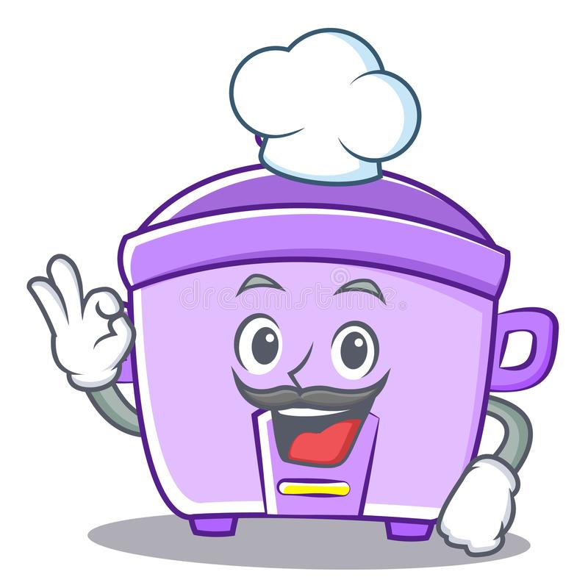
Matching type with rice.

Slide 44
What are the words that help get the correct steps in cooking rice?

Slide 45
Let’s group a few signal words

Slide 46
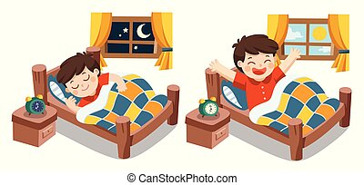
What do you do after waking up in the morning?

Slide 47
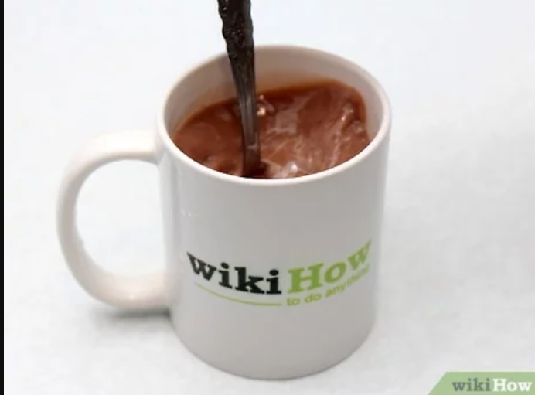

Slide 48
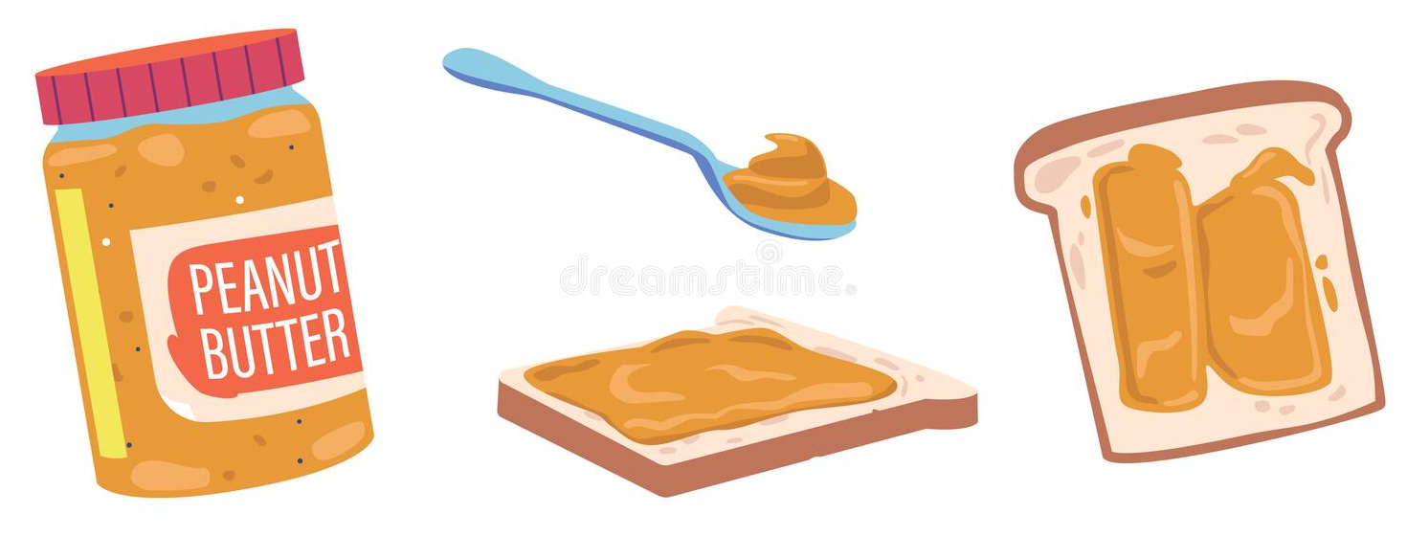

Slide 49
The directions on how to make a peanut butter sandwich are not in their proper order. Which steps below gives the correct directions?
A. Afterwards, put the two slices of bread together.
B. First, get two slices of bread.
C. Lastly, cut the sandwich diagonally.
D. Next, spread peanut butter on one slice of bread.
A. ADCD B. BDAC C. ACDB D. BDCA
.

Slide 50
These words are signal words.
The words First, Next, Then, Afterwards, and Lastly were used to follow the directions in their correct order. These are the words that signal what is the next step to follow. These words are called connectives, or sequence words, or signal words.
.

Slide 51
In writing directions using signal words, use a comma after the signal words.

Slide 52
First,
Next,
Then,
Finally,

Slide 53
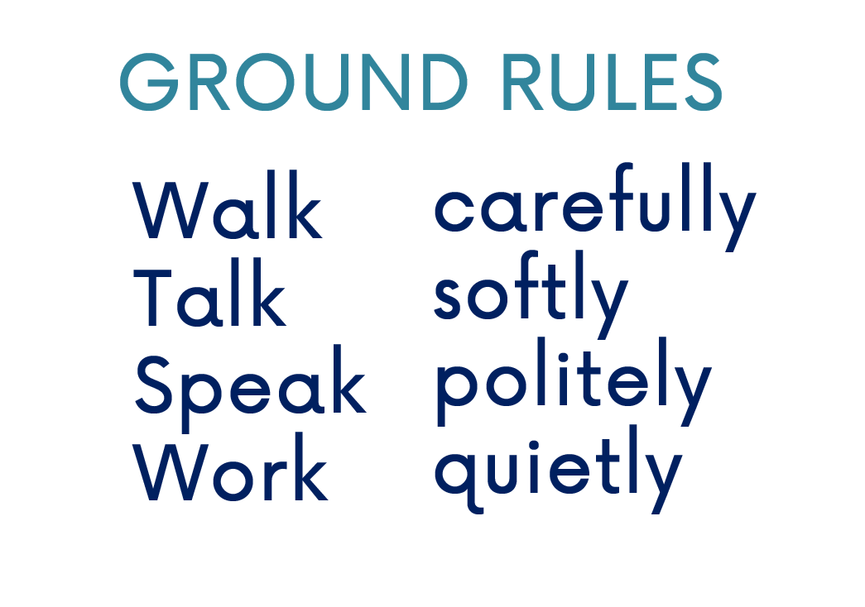
Group Activity

Slide 54
.
What are the signal words?
Why do we have to learn about signal words?
What will happen if you will not follow the directions or steps properly?

Slide 55
.
Direction: Read each item carefully. Choose the letter of the best answer.
1. Which of the following signal words is NOT correctly spelled?
a. finaly c. lastly
b. then d. additionally

Slide 56
2. Which among the signal words are arranged in order?
A. Lastly, Next, Then, First
B. First, Next, Lastly, After that
C. First, Next, Then, Lastly
D. Next, After that, Finally,
Afterwards

Slide 57
3. Which of the following words does not belong to the group?
a. then c. next
b. that d. afterwards

Slide 58
4. _________, gather all your ingredients before you start cooking. Which signal words to use in order to complete this sentence?
a. then c. next
b. first d. lastly

Slide 59
5. The directions on how to make egg sandwich are not in their proper order. Which steps below gives the correct directions?
A. First, prepare the eggs for boiling.
B. Lastly, you have now a delicious egg sandwich.
C. Next, get the boiled eggs and remove the shells.
D. Then, slice the eggs in small pieces and mix with mayonnaise.
E. Afterwards, spread over your favorite sliced bread.
A. ABCDE B. ACDEB C. ACDBE D. ADBCE

Slide 60
Assignment: Create 2-3 steps on how to draw a simple house using the signal words you have learned in this lesson.

